Slide 1
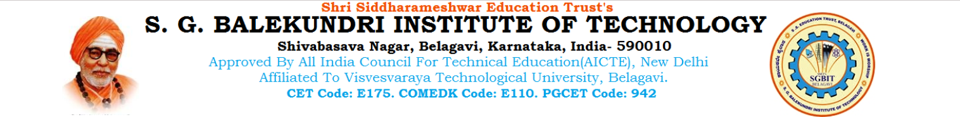
POLYRECYCLER BIN
RECYCLE AND EARN
UNDER THE GUIDANCE OF : PROF. CHITRASHREE.K
“FINAL PHASE PRESENTATION” BACHELOR OF ENGINEERING IN COMPUTER SCIENCE AND ENGINEERING
PROJECT TEAM:
ASHWINI T. FALAQ K. PRADNYA P.
TRUPTI H. TRUPTI M.

Slide 2
CONTENTS:
1. INTRODUCTION
2. OBJECTIVE
3. PROBLEM STATEMENT
4. METHODOLOGY
5. RESULTS
6. CONCLUSION AND FUTURE ENHANCEMENT

Slide 3
INTRODUCTION:
Modern world meets a lot of challenges that includes smart waste management system. It is becoming a matter of big concern if proper disposal system is not well managed. A nation can be said ahead of others if it can manage the waste effectively and recycling efficiently.
The concept of automating the processing and disposal of solid waste is not new. Currently, there exist various types of machinery which attempt to sort one material from another with differing degrees of success.
In this work, Arduino UNO, servo motors, LCD display RFID are used. The main function of automatic sorting machine is to separate different materials found in waste streams and minimizing the amount of goods sent to landfill.

Slide 4
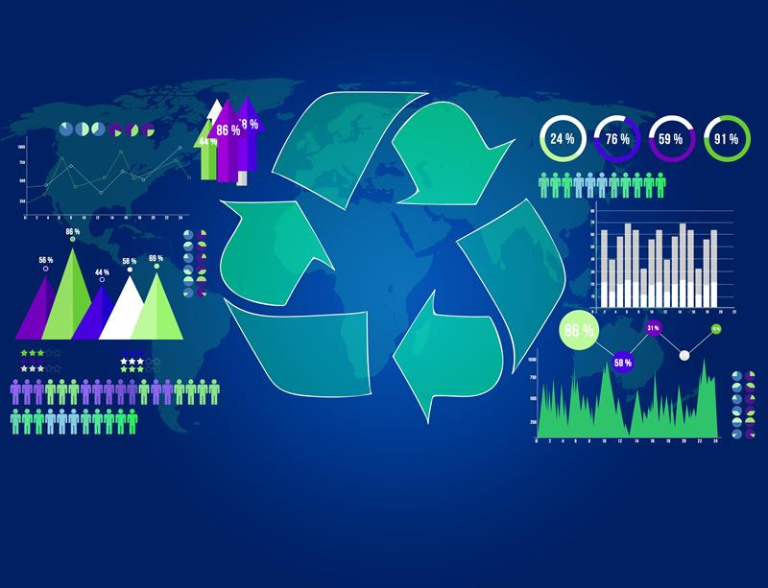
Our system implements a standard recycle bin maintaining the conventional procedure for the user to dump the waste. Our product evaluates the dump waste according to its weight, type, number and shape of the recycle waste.
This will benefit the users as well as the authorities that involved in waste management as all the transactions will be recorded in archive of this automated system.
This product will emerge “waste to wealth” concept by motivating and encouraging people to recycle as they will be rewarded and eventually increase their awareness on the importance of waste recycling.

Slide 5
OBJECTIVE:
This project aim is to develop a prototype of Reverse Vending Machine (Smart Recycle and Reward Bin). This prototype enables the user to recycle plastic bottles, beverage containers and gets reward points. Through image processing , the container material is recognized and it is then dropped into respective bins with the help of servo motors. In return, reward points are credited into stored value card (RFID) according to items recycled.
The objectives of the project are:
To implement RFID contactless smartcard as the electronic reward system.
To implement a user friendly interface and display system.
To create a database for authorized personnel to keep track of recycling activities, undertake remote problem solving and error checking.

Slide 6
PROBLEM STATEMENT:
The consumption and disposal of single-use plastic bottles (SPBs) is a global, national, and campus issue. Despite being attractive to manufacturers and consumers as a cheap, resealable alternative to glass or aluminum, SPBs have extremely detrimental effects on people and the environment. As a petrochemical product made from crude oil, plastic can take from 450 to 1,000 years to decompose, all the while taking up valuable space in landfills and in our oceans. At the current rate of production and consumption, there will be more plastic in the ocean than fish by 2050 . In addition, plastics can be challenging to recycle, and capabilities to do so differ by locality and thus can be difficult for consumers to monitor.

Slide 7
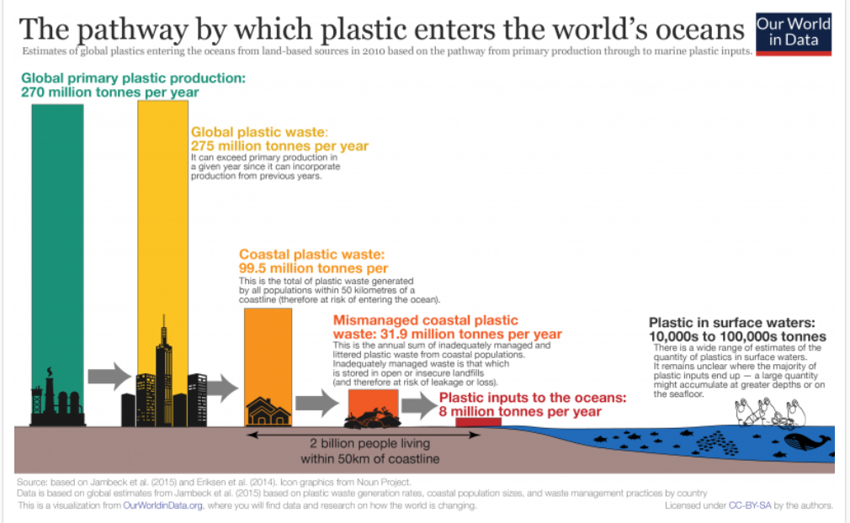

Slide 8
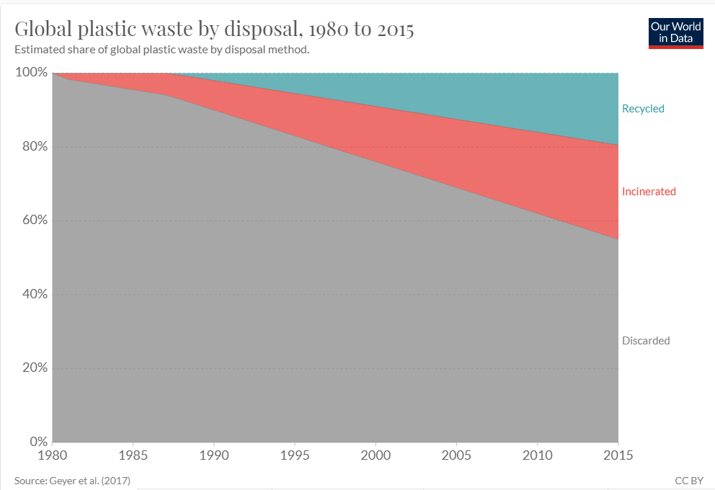

Slide 9
METHODOLOGY:
This project can be advantageous at various locations not limited to railway stations, bus stands or shopping malls. The huge amount of plastic bottle wasted which is dumped on these public places can be easily collected if such machines are installed at these places.
This is a device that accepts used plastic containers and returns money to the user.
The basic operations involve steps where the recycler places the empty bottle/can into the receiving aperture, the horizontal in-feed system allows the user to insert containers one at a time. The bottle/can is then automatically scanned.
As for the reward system, it distributes valuable tokens, like coins or coupons, when beverage containers are recycled.

Slide 10
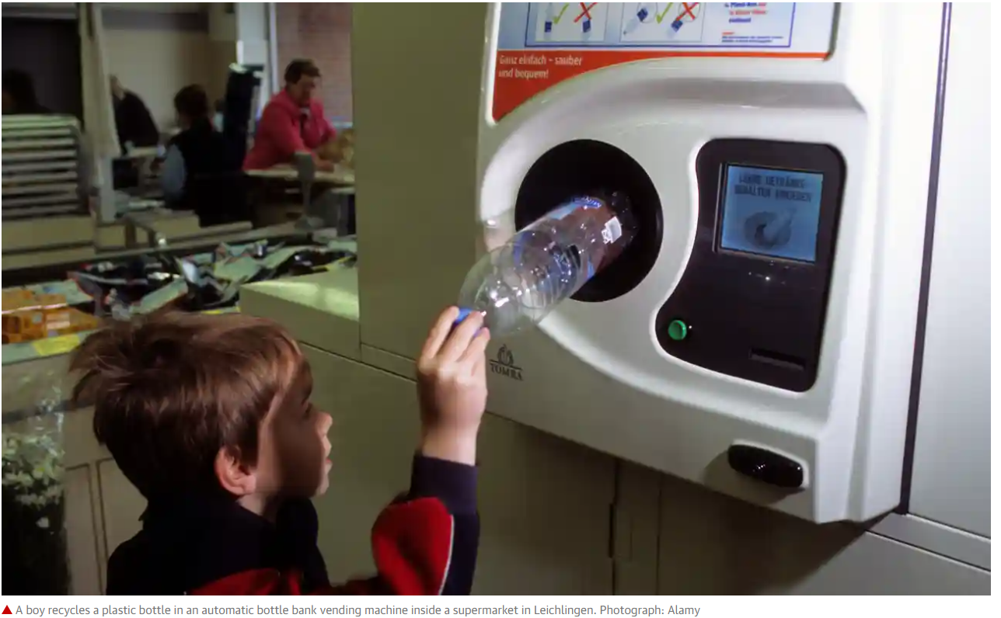
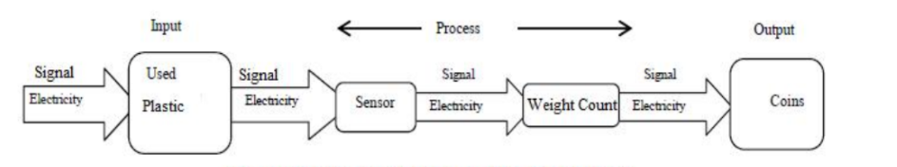
EXISTING SYSTEM:
Germany started the action of plastic bottle recycling and Beverage can recycling in the year of 2003, becoming the first country to do that in Europe. This deposit system aims to do the work of plastic bottle recycling in a more efficient way, by which every citizen forms the awareness and habit of recycling and environmental protection. There are special recycling machines for plastic bottles in many supermarkets, customers can get their deposit back after they put the empty bottles into the recycling machines.

Slide 11
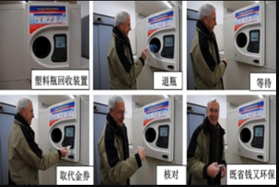
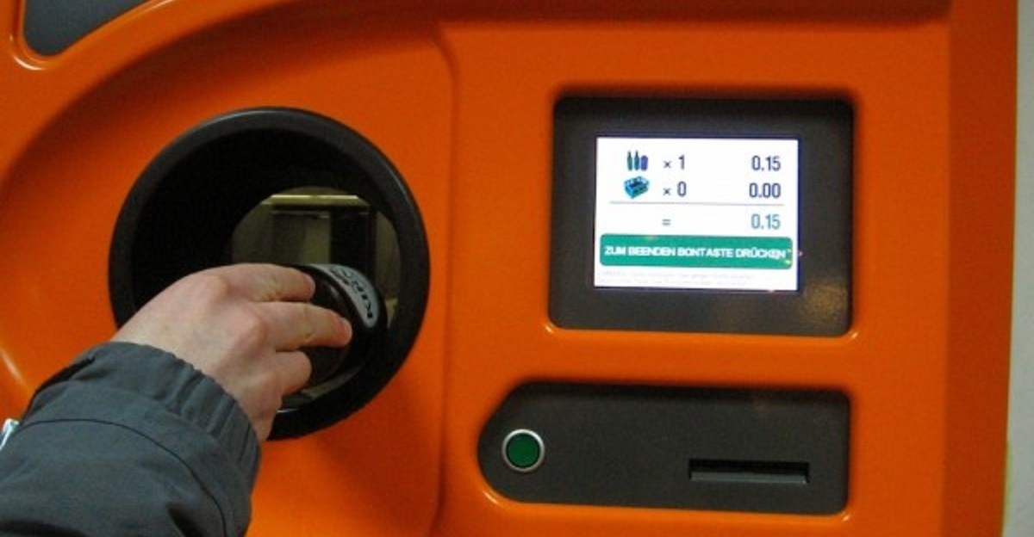

Slide 12
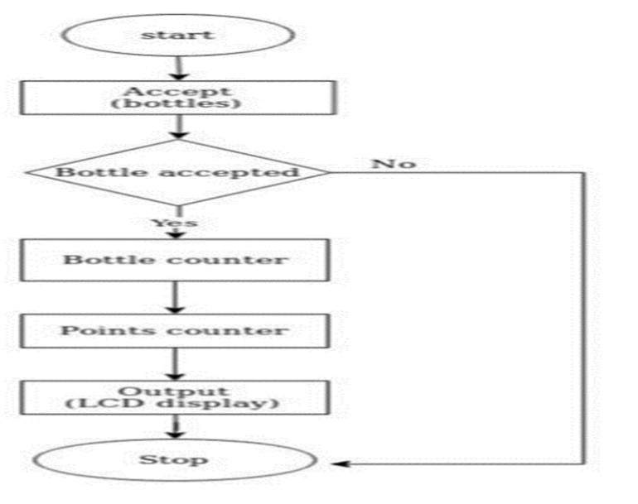
OUR SYSTEM/MODEL:
ALGORITHM:
MAIN COMPONENTS USED:
RFID
WEB CAMERA
ARDUINO UNO
SERVO MOTOR
I2C MODULE
LCD DISPLAY

Slide 13
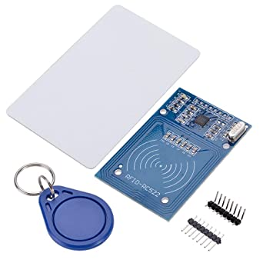
RFID: RADIO FREQUENCY IDENTIFICATION:
The basic concept of operation is:
An Antenna sends out & receives radio signals. These signals are received & returned by an RFID tag with information added.
A reader which is integrated with a system accepts & stores these data called & finally they trigger actions.
Voltage: DC 3.3V
Operating Current :13-26mA
Idle Current :10-13mA
Operating Frequency: 13.56MHz
Highly integrated analog circuitry to demodulate and decode responses.

Slide 14
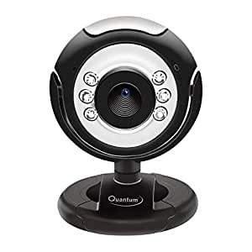
WEB CAMERA:
Object detection refer the capability of computer and software systems to locate object in image and identify each object. Object detection has been widely used for applications such as face detection, vehicle detection.
We use Teachable Machine to recognize images, sounds or poses. Upload your own image files, or capture them live with a mic or webcam.
Image resolution 25 mega pixels with 6 light sensors ; 16 MP Image Resolution ; USB Interface Image control colour saturation, brightness, sharpness and brightness is adjustable.
Focus Range 4cm to infinity; Resolution hardware: 500K pixels; Image quality: RGB24 or I420.

Slide 15
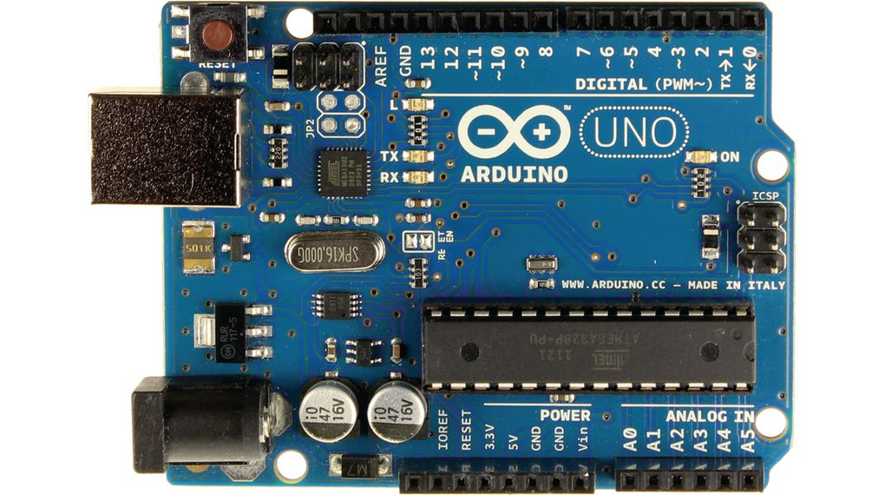
ARDUINO UNO:
Microcontroller: ATmega328
Operating Voltage: 5V
Input Voltage (recommended): 7-12V
Input Voltage (limits): 6-20V
Digital I/O Pins: 14 (of which 6 provide PWM output)
Analog Input Pins: 6
DC Current per I/O Pin: 40 mA
DC Current for 3.3V Pin: 50 mA
Flash Memory: 32 KB of which 0.5 KB used by bootloader
SRAM: 2 KB (ATmega328); EEPROM: 1 KB (ATmega328)
Clock Speed: 16 MHz
Arduino uno is an open-source electronics platform based on easy-to-use hardware and software. Arduino boards are able to read inputs - light on a sensor, a finger on a button, or a Twitter message - and turn it into an output - activating a motor, turning on an LED, publishing something online.

Slide 16
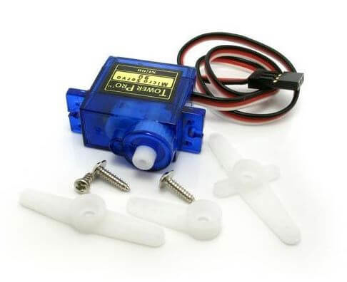
SERVO MOTOR:
Servo motors or “servos”, as they are known, are electronic devices and rotary or linear actuators that rotate and push parts of a machine with precision.
Servos are mainly used on angular or linear position and for specific velocity, and acceleration.

Slide 17
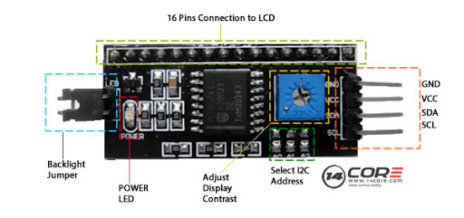
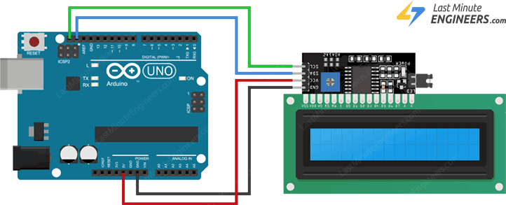
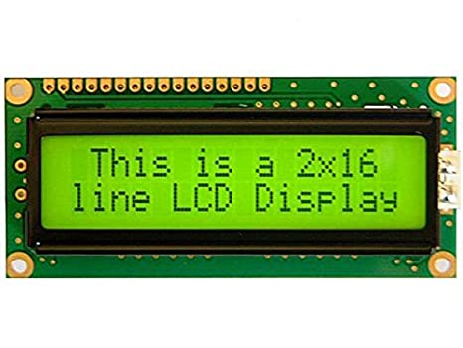
I2C MODULE & LCD DISPLAY:
I2C_LCD is an easy-to-use display module. It can make display easier. Using it can reduce the difficulty of make, so that makers can focus on the core of the work. We developed the Arduino library for I2C_LCD, user just need a few lines of the code can achieve complex graphics and text display features.

Slide 18
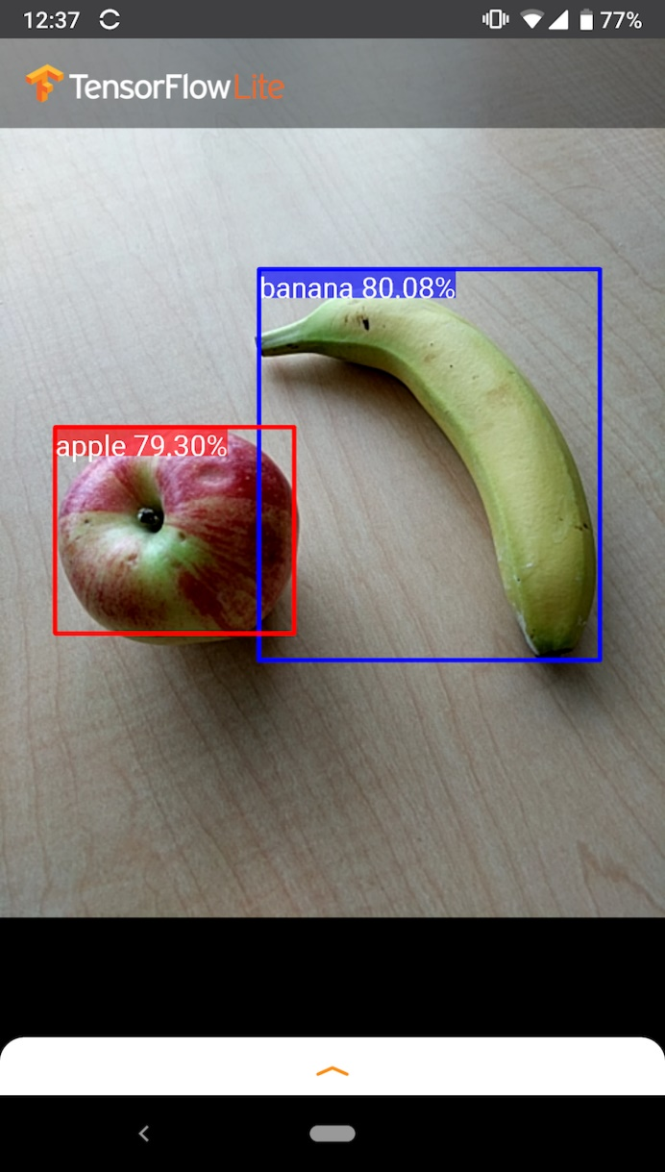
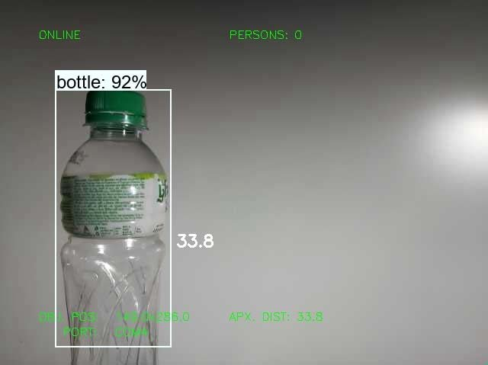
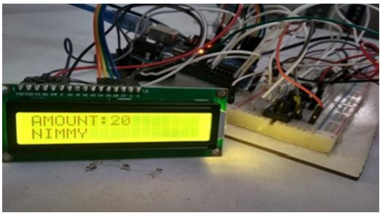
SCREENSHOTS:

Slide 19
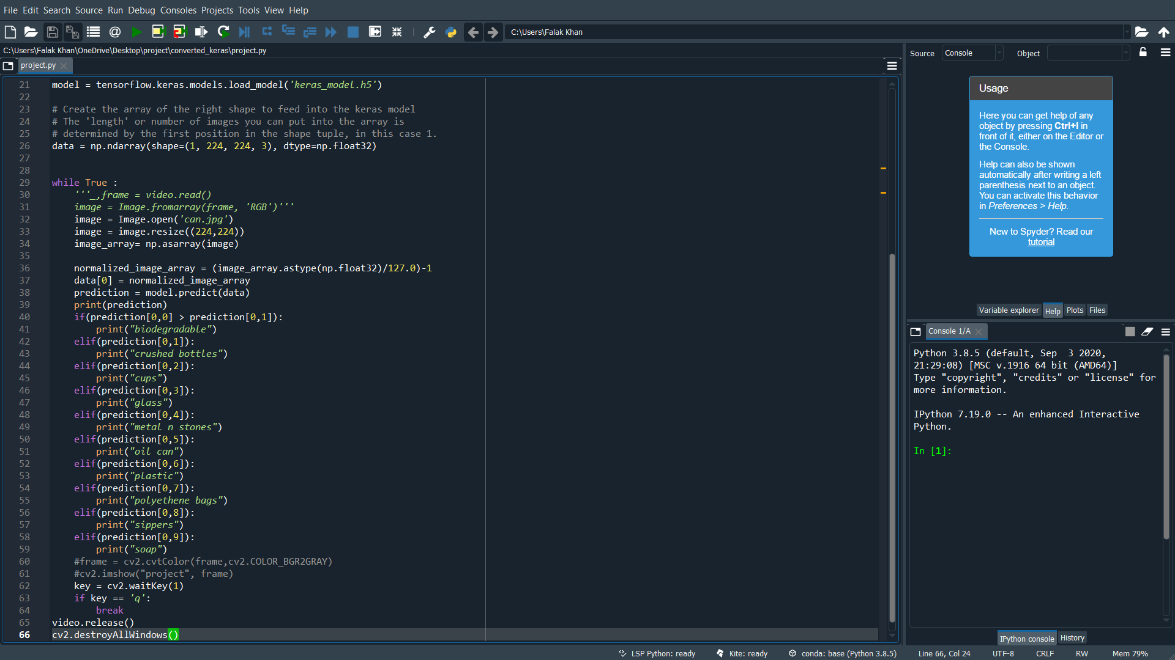

Slide 20
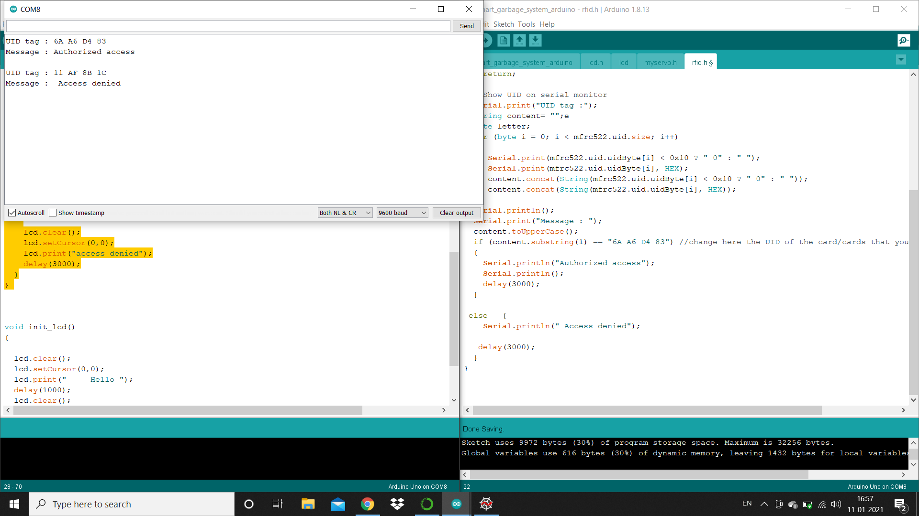

Slide 21
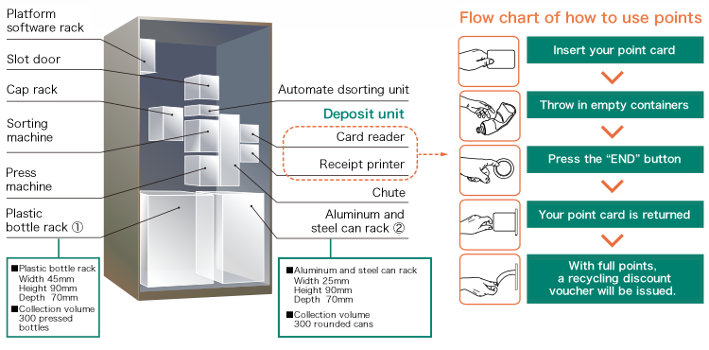
RESULT:

Slide 22
CONCLUSION:
In this project, a prototype of the Smart Plastic Recycle Machine is successfully simulated. User inputs plastic material into the system, the system enables the summation of points throughout the recycling process.
The reward coins and weight of plastic increment with every input to the system. If the user inputs an invalid object or invalid type item into the system, system cannot except the input material and reset the system.
The system will work efficiently and cost effective in implementing the design of creating the recycle machine’s programmable hardware-based detection system using image processing. The future scope of this proposed of this project is to implement whole system on hardware.

Slide 23
THE CHALLENGES & SCOPE:
Improved detection accuracy of the recycling system.
Sorting system for different materials.
Redemption of reward points.
Lower energy consumption.
Easy disposal and collection system.
IMPLEMENTATION:
RELIABILITY: The machine will be able to work with minimum supervision.
ACCURACY: The machine will be able to detect plastic objects with image processing also differentiate it with other non-plastic objects.
RESPONSE TIME: The machine will be able to complete operation fast. Transaction time should be minimum for the user.
EFFICIENCY: The machine must accept all types of plastic objects irrespective of all sizes, shape & color. And reject non-plastic objects.
FUNCTIONALITY: The machine must be able to function and complete process of operation without fail starting from detection to crediting the reward.

Slide 24
FUTURE ENHANCEMENT:
The remaining problems and scopes of this work are:
1. Improved detection accuracy
2. Simpler user identification method
3. Can accept glass bottles
4. Can implement ticket vending in return of plastic bottles
5. Can interlink online bank accounts for funds transfer
6. Can issue Cards (like debit cards)
7. Solar energy can be used for power supply
8. Can be used by large number of people

Slide 25
REFERENCES:
Maofic Farhan Karin, Khandaker Sharif Noor, Hasan U. Zaman Department of Electrical & Computer EngineeringNorth South University “Hardware Based Design and Implementation of a Bottle Recycling Machine using FPGA”proceedings of 978-1-5090-1181-0/16/$31.00 ©2016 IEEE.
Seyed Bahram Zahir Azami & Mohammad Tanabian “Automatic Mobile Payment on a non- Connected VendingMachine” proceedings of Canadian Conference on Electrical and Computer Engineering, May 2004, pp- 731-734 Niagara Falls, Ontario,Canada.
K. Martinko, "Pay for your subway ride in Beijing by recycling a plastic bottle",TreeHugger, 2014. [Online].Available: http://www.treehugger.com/culture/pay-your-subway-ride-beijingrecycling- plastic-bottle.html.
[Accessed: 05-Jan-2016].
s

Slide 26
THANK YOU

